Slide 1
CSE 185 Introduction to Computer Vision
Light and color

Slide 2
Light and color
Human eye
Light
Color
Projection
Reading: Chapters 2,6

Slide 3
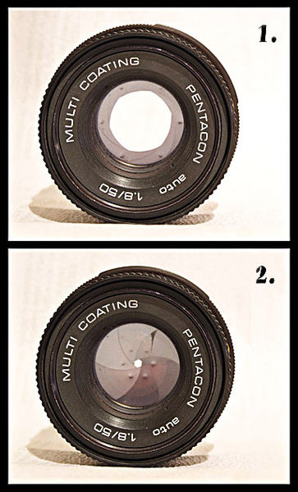
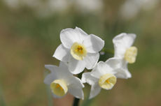
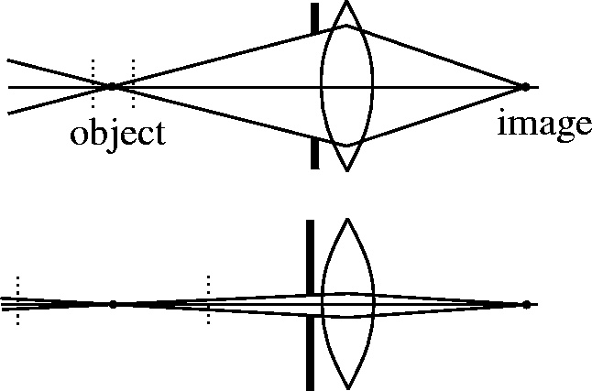
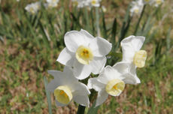
Camera aperture
f / 5.6 (large aperture)
f / 32 (small aperture)

Slide 4
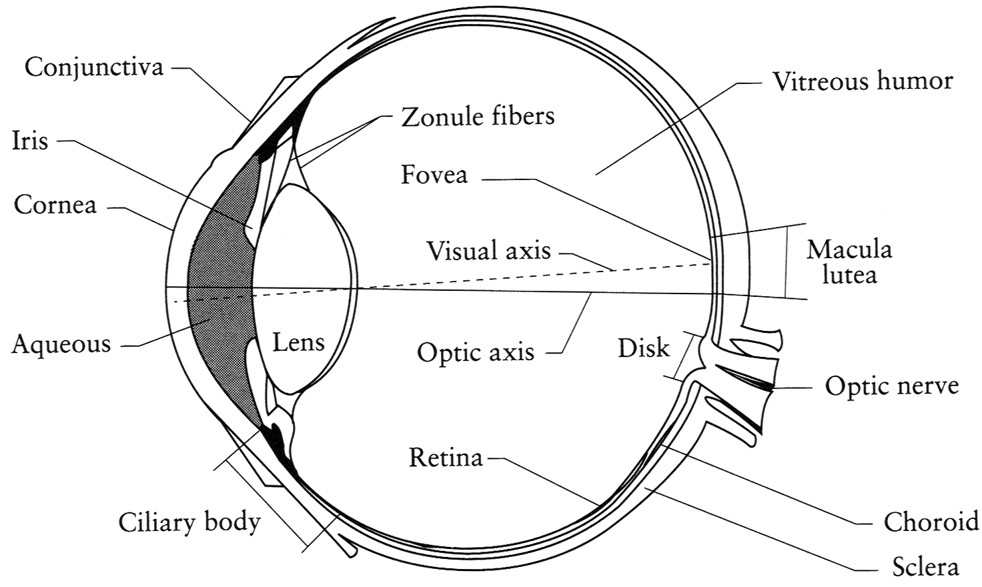
The human eye
The human eye is a camera
Iris: colored annulus with radial muscles
Pupil: the hole (aperture) whose size is controlled by the iris
What’s the “film”?
photoreceptor cells (rods and cones) in the retina
Notes:
Note that the retina is curved

Slide 5
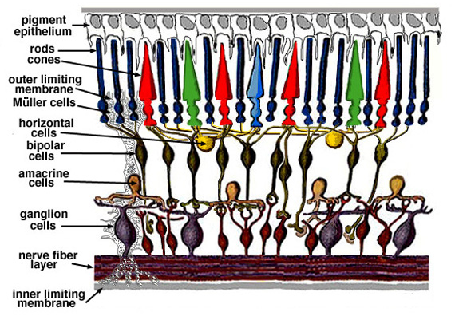
Human eye
Retina: thin, layered membrane with two types of photoreceptors
rods: very sensitive to light but poor spatial detail
cones: sensitive to spatial details but active at higher light level
generally called receptive field

Slide 6
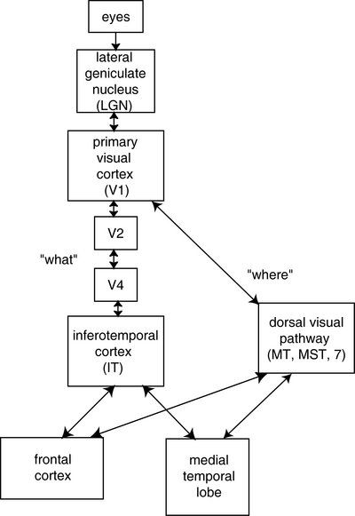
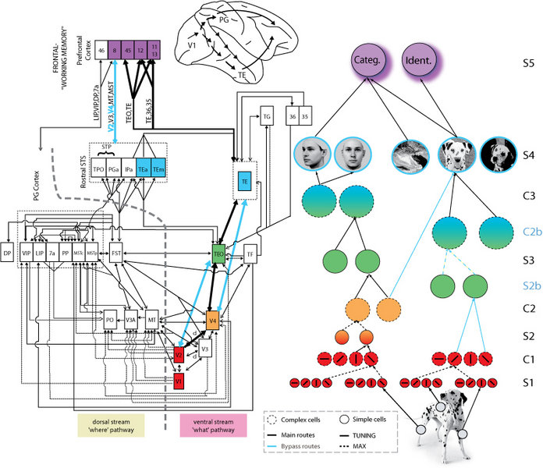
Human vision system (HVS)

Slide 7
Exploiting HVS model
Flicker frequency of film and TV
Interlaced television
Image compression

Slide 8





JPEG compression
Uncompressed 24 bit RGB bit map: 73,242 pixels require 219,726 bytes (excluding headers)
Q=100 Compression ratio: 2.6
Q=50 Compression ratio: 15
Q=25 Compression ratio: 23
Q=10 Compression ratio: 46
Q=1 Compression ratio: 144

Slide 9
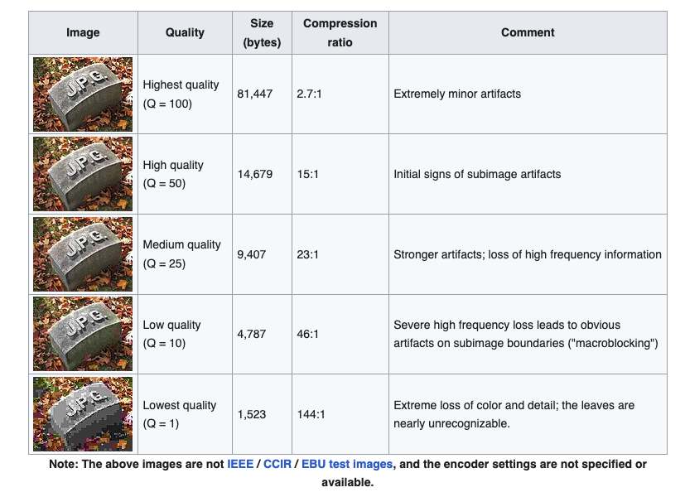
JPEG compression

Slide 10
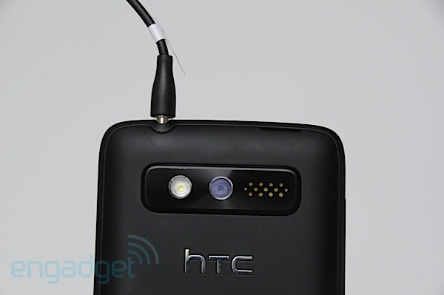
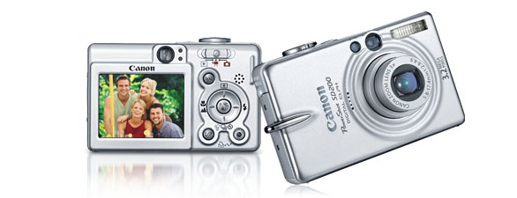
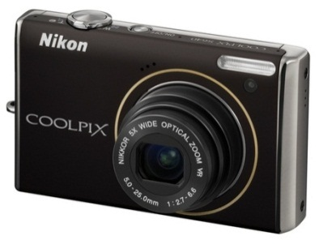
Digital camera
CCD vs. CMOS
Low-noise images
Consume more power
More and higher quality pixels
More noise (sensor area is smaller)
Consume much less power
Popular in camera phones
Getting better all the time
http://electronics.howstuffworks.com/digital-camera.htm

Slide 11
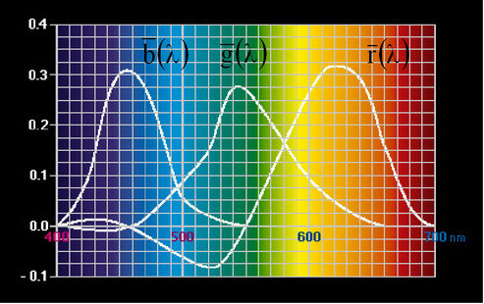
Color
What colors do humans see?
The colors of the visible light spectrum
color wavelength interval frequency interval
red ~ 700–635 nm ~ 430–480 THz
green ~ 560–490 nm ~ 540–610 THz
blue ~ 490–450 nm ~ 610–670 THz

Slide 12
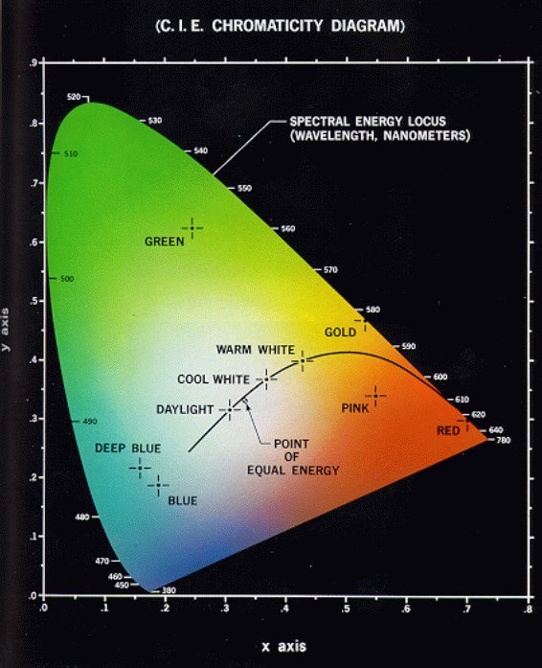
Color
Plot of all visible colors (Hue and saturation):
Color space: RGB, CIE LUV, CIE XYZ, CIE LAB, HSV, HSL, …
A color image can be represented by 3 image planes

Slide 13
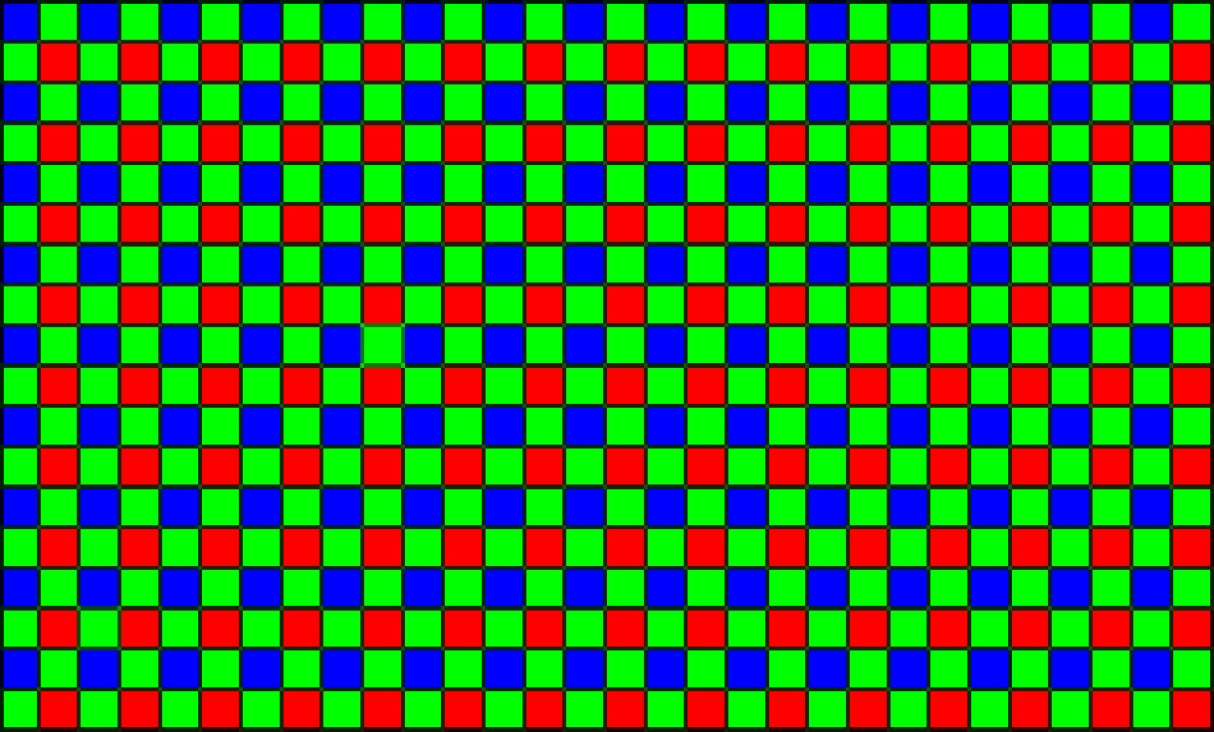
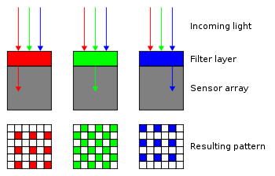

Bayer pattern
Color filter array
A practical way to record primary colors is to use color filter array
Single-chip image sensor: filter pattern is 50% G, 25% R, 25% B
Since each pixel is filtered to record only one color, various demosaicing algorithms can be used to interpolate a set of complete RGB for each point
Some high-end video cameras have 3 CCD chips

Slide 14





Demosaicing
original reconstructed

Slide 15
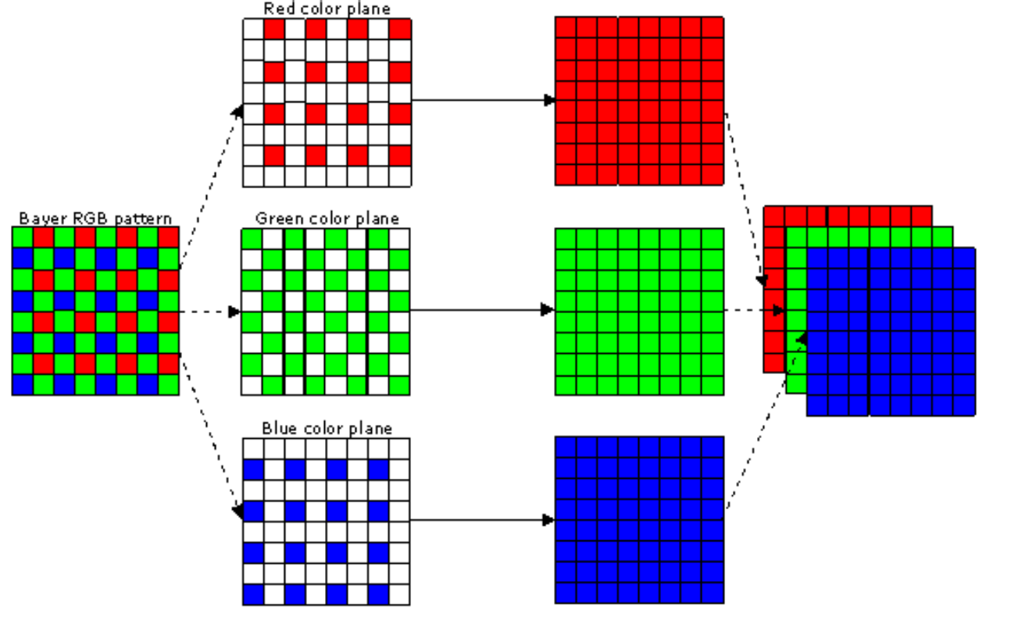
Demoasicing

Slide 16
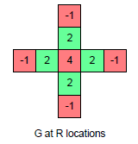
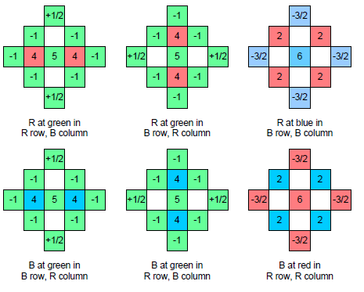
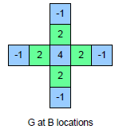
Demosaicing
How can we compute an R, G, and B value for every pixel?

Slide 17
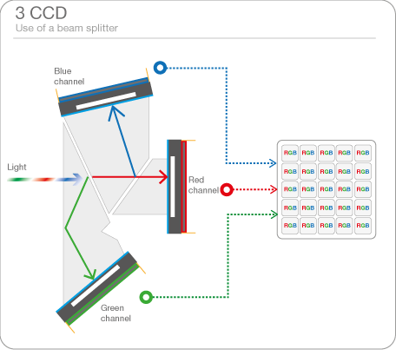
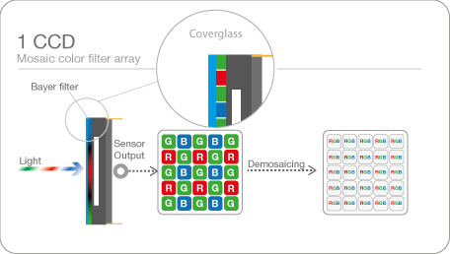
Color camera
Bayer mosaic color filter
CCD prism-based color configuration

Slide 18
Grayscale image
Mainly dealing with intensity (luminance)
Usually 256 levels (1 byte per pixel): 0 (black) to 255 (white) (often normalized between 0 and 1)
Several ways to convert color to grayscale, e.g., Y=0.2126R+0.7152G+0.0722B

Slide 19
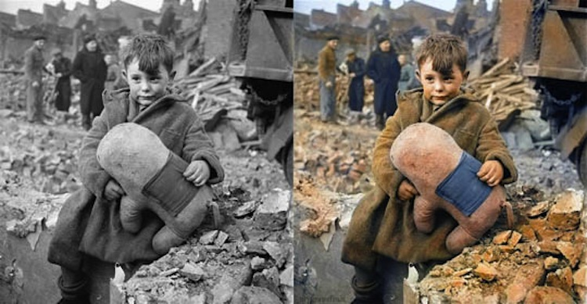
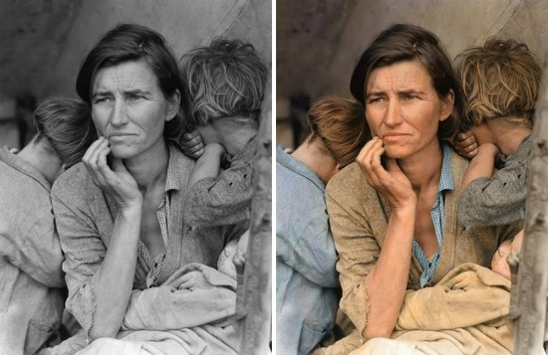
Recolor old photos
http://twistedsifter.com/2013/08/historic-black-white-photos-colorized/

Slide 20
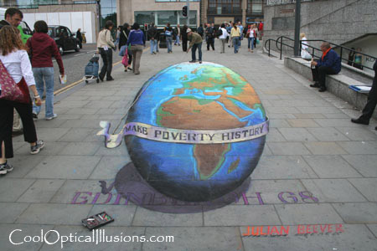
Projection
See Szeliski 2.1

Slide 21
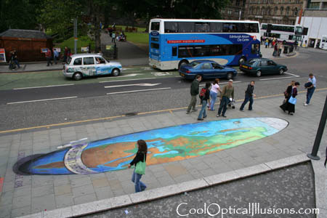
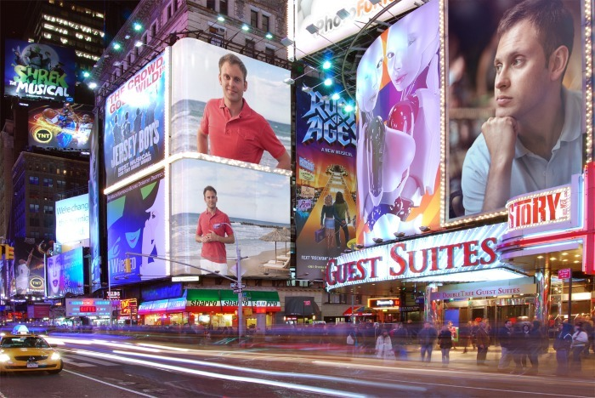
Projection
Fun application
PhotoFunia

Slide 22
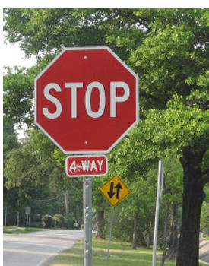


Correspondence and alignment
Correspondence: matching points, patches, edges, or regions across images
≈

Slide 23
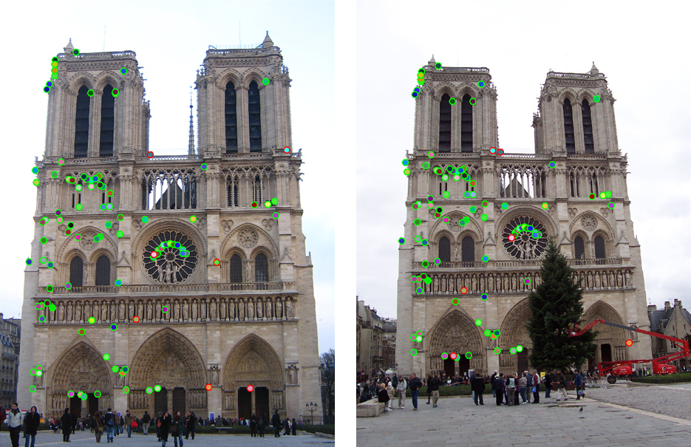
How do we fit the best alignment?

Slide 24
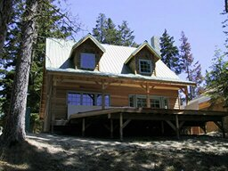
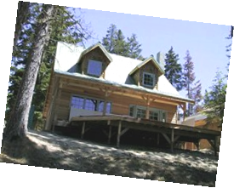
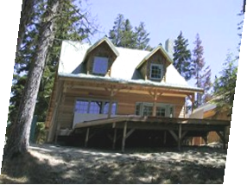
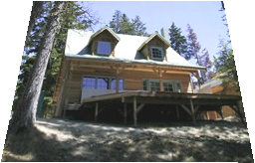
Common transformations
original
Transformed
translation
rotation
aspect
affine
perspective

Slide 25
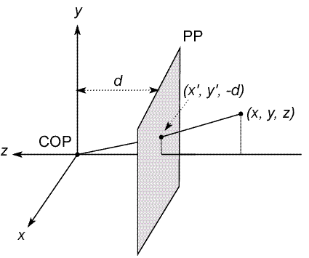
Modeling projection
The coordinate system
We will use the pin-hole model as an approximation
Put the optical center (Center Of Projection) at the origin
Put the image plane (Projection Plane) in front of the COP
The camera looks down the negative z axis
we need this if we want right-handed-coordinates
Notes:
This way the image is right-side-up

Slide 26
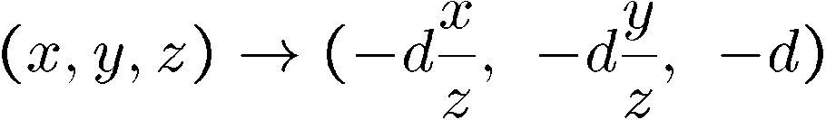
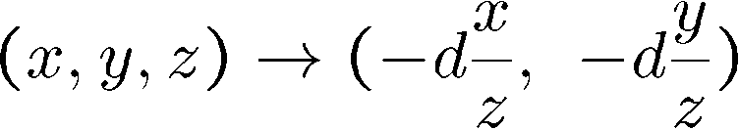
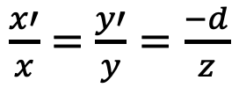
Modeling projection
Projection equations
Compute intersection with PP of ray from (x,y,z) to COP
Derived using similar triangles
$\frac{x′}{x}=$ $\frac{y′}{y}=\frac{−d}{z}$
We get the projection by throwing out the last coordinate:

Slide 27
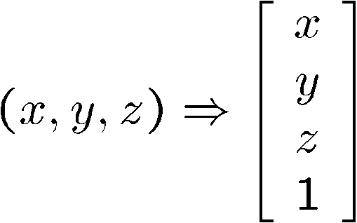
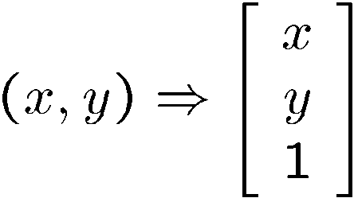
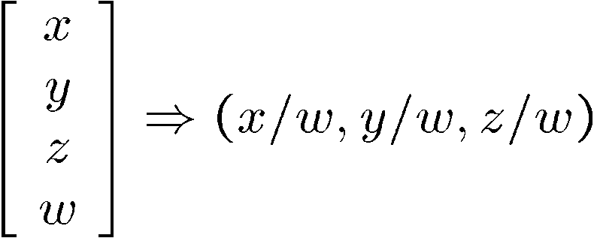
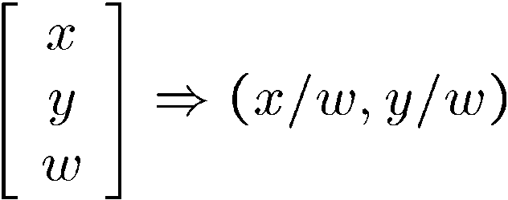
Homogeneous coordinates
Is this a linear transformation?
Trick: add one more coordinate:
no—division by z is nonlinear
homogeneous image
coordinates
homogeneous scene
coordinates
Converting from homogeneous coordinates

Slide 28
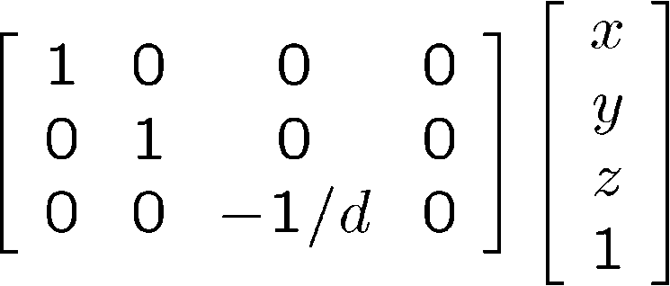
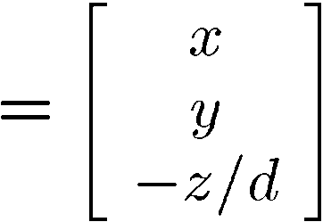
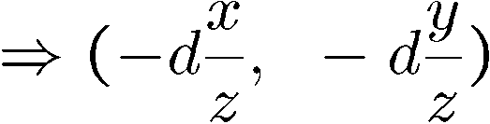
Perspective projection
Projection is a matrix multiply using homogeneous coordinates:
divide by third coordinate
This is known as perspective projection
The matrix is the projection matrix

Slide 29
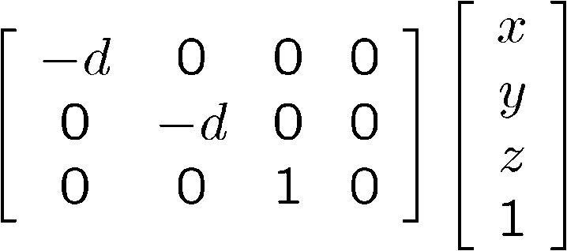
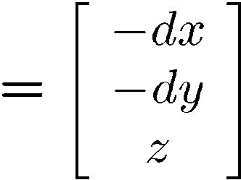
Perspective projection
How does scaling the projection matrix change the transformation?

Slide 30
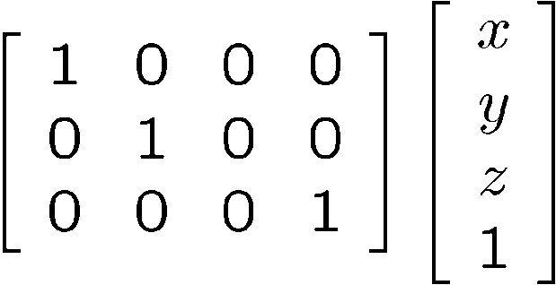
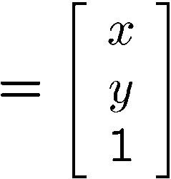

Orthographic projection
Special case of perspective projection
Distance from the COP to the PP is infinite
Good approximation for telephoto optics
Also called “parallel projection”: (x, y, z) → (x, y)
What’s the projection matrix?
Image
World

Slide 31
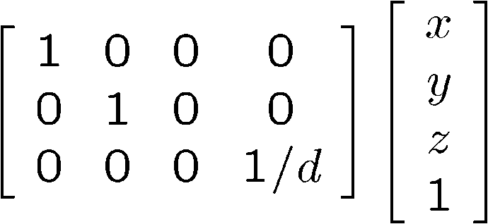
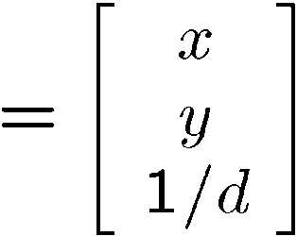


Orthographic projection variants
Scaled orthographic
Also called “weak perspective”
Affine projection
Also called “paraperspective”

Slide 32






Camera parameters
See MATLAB camera calibration example

Slide 33





Camera parameters
A camera is described by several parameters
Translation T of the optical center from the origin of world coords
Rotation R of the image plane
focal length f, principle point (x’_{c}, y’_{c}), pixel size (s_{x}, s_{y})
yellow parameters are called extrinsics, red are intrinsics
Projection equation
The projection matrix models the cumulative effect of all parameters
Useful to decompose into a series of operations
identity matrix
intrinsics
projection
rotation
translation
The definitions of these parameters are not completely standardized
especially intrinsics—varies from one book to another

